Slide 1


Slide 2
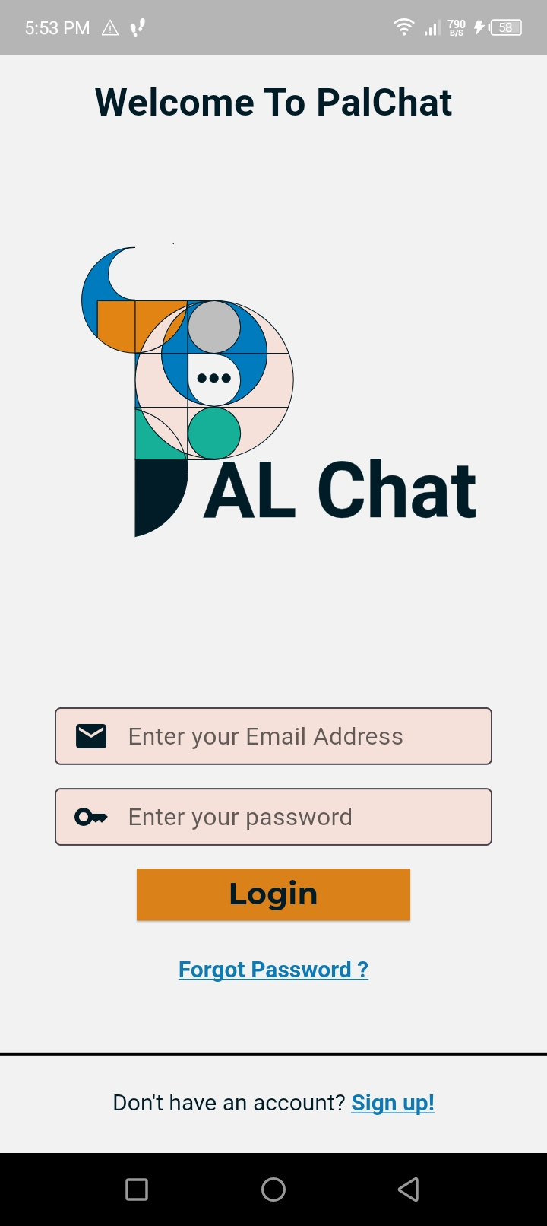
#F2F2F2
Background color:
Easy on the eyes for long navigation sessions
#011C27
#F5E1DA
Still don’t know what to say
#E28413
Used for call to action buttons:
Bright and eye catching to catch the attention of the user

Slide 3
